Slide 1
PRACTICAL ASSESSMENT
TCP/IP Model: Protocols, Layer Functions & Practical Demonstration
Application
Transport
Internet
Assignment: Use Packet Tracer or a similar tool to demonstrate and explain the TCP/IP model and its protocols with clear examples at each layer. How does the TCP/IP model differ from the OSI model?
Network Access
Presented by: Alain Mugisha
Network & Security Engineer
Notes:
Introduce the assignment and yourself. State that you will explain the TCP/IP model and demonstrate it in Cisco Packet Tracer.

Slide 2
Presentation Objectives
1
2
3
Explain the TCP/IP model and its four layers.
Identify major protocols at each layer.
Demonstrate TCP/IP communication using Cisco Packet Tracer.
4
5
6
Explain encapsulation and de-encapsulation.
Demonstrate HTTP, TCP, IP, ICMP, ARP and Ethernet.
Compare TCP/IP with the OSI reference model.
TCP/IP Model | Practical Assessment
2
Notes:
My objective is not only to explain the TCP/IP model theoretically, but also to demonstrate how the protocols actually work together during network communication.

Slide 3
What is the TCP/IP Model?
Application
Network services
TCP/IP
HTTP, DNS, DHCP, SSH
Transmission Control Protocol / Internet Protocol
Transport
End-to-end communication
A networking model used to describe how devices communicate across IP networks.
TCP, UDP
Internet
Addressing & routing
KEY IDEA
IPv4, IPv6, ICMP
Application → Transport → Internet → Network Access
Network Access
Local network delivery
Ethernet, ARP, MAC
TCP/IP Model | Practical Assessment
3
Notes:
Walk through the four traditional layers, the main function of each, and example protocols.

Slide 4
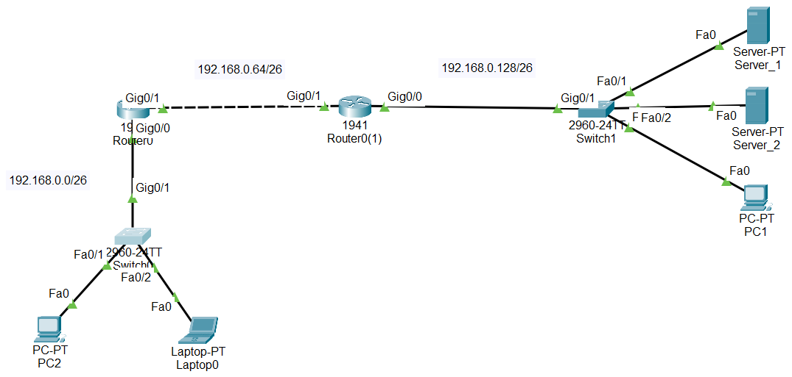
Packet Tracer Network Topology
Device | Interface | IP Address
PC2 | Fa0 | 192.168.0.2/26
Router0 | G0/0 | 192.168.0.1/26
Router0 | G0/1 | 192.168.0.65/26
Router0(1) | G0/1 | 192.168.0.66/26
Router0(1) | G0/0 | 192.168.0.129/26
Server_1 | Fa0 | 192.168.0.130/26
PURPOSE PC2 will access a web service running on Server_1, crossing two routers and three subnets.
TCP/IP Model | Practical Assessment
4
Notes:
Explain the topology: three /26 subnets. 192.168.0.0/26 holds PC2, Laptop0 and Switch0. 192.168.0.64/26 is the link between Router0 and Router0(1). 192.168.0.128/26 holds Switch1, Server_1, Server_2 and PC1.

Slide 5
Application Layer
Provides network services directly to applications and users.
PACKET TRACER DEMONSTRATION
1
Configure Server_1
HTTP / HTTPS
Web communication
Server_1 > Services > HTTP > ON
DNS
Name resolution
2
From PC2, open the browser
DHCP
Automatic IP configuration
Desktop > Web Browser
SSH
Secure remote administration
3
Enter the address
FTP
File transfer
http://192.168.0.130
TCP/IP Model | Practical Assessment
5
Notes:
The user interacts with the web browser, but underneath the browser, HTTP communicates with the server using the lower TCP/IP layers.

Slide 6
Transport Layer
TCP
Connection-oriented and reliable
TCP 3-Way Handshake
Client
Server
Sequencing
Acknowledgements
Retransmission
Reliable delivery
Flow control
SYN
SYN-ACK
Used by: HTTP, HTTPS, SSH, FTP
ACK
UDP
Connectionless, low overhead
Connection Ready
No TCP-style acknowledgement or retransmission mechanism.
192.168.0.130:80 IP finds the host; the port finds the service.
Used by: DNS (usually), DHCP
TCP/IP Model | Practical Assessment
6
Notes:
IP identifies the destination host, while the TCP or UDP port identifies the application or service on that host. Example: 192.168.0.130:80.

Slide 7
Internet Layer
MAIN PROTOCOLS
PACKET TRACER DEMONSTRATION
IPv4
IPv6
ICMP
From PC2
ping 192.168.0.130
MAIN FUNCTIONS
1
Logical addressing
Ping uses ICMP Echo Request and Echo Reply.
2
Packet forwarding
On Router0
show ip route
3
Routing
The router checks the destination IP and uses its routing table to decide where to forward the packet.
4
Network-to-network communication
TCP/IP Model | Practical Assessment
7
Notes:
The router examines the destination IP address and uses its routing table to determine where the packet should be forwarded.

Slide 8
Network Access Layer
Ethernet
MAC addressing
ARP
PACKET TRACER
On PC2
PC2 needs its default gateway: 192.168.0.1
arp -a
IP Address
ARP
MAC Address
On Switch0
show mac address-table
Ethernet needs a destination MAC address.
SWITCH
ROUTER
Forwards Ethernet frames using MAC addresses.
Makes forwarding decisions using IP addresses.
TCP/IP Model | Practical Assessment
8
Notes:
The switch forwards Ethernet frames using MAC addresses, while the router makes forwarding decisions using IP addresses.

Slide 9
Encapsulation
Application
DATA
DATA
Transport
TCP Hdr
DATA
TCP Segment
Internet
IP Hdr
TCP Hdr
DATA
IP Packet
Network Access
Eth Hdr
IP Hdr
TCP Hdr
DATA
FCS
Ethernet Frame
Sending: Data → Segment → Packet → Frame
De-encapsulation: Frame → Packet → Segment → Data
TCP/IP Model | Practical Assessment
9
Notes:
This is one of the most important slides. When PC2 sends an HTTP request, data becomes a TCP segment, then an IP packet, then an Ethernet frame. At the destination the reverse process, de-encapsulation, restores the data.

Slide 10
Practical Demonstration: HTTP Communication
PC2
Switch0
Router0
Router0(1)
Switch1
Server_1
1
Switch to Simulation Mode.
PROTOCOL STACK
HTTP
2
Generate HTTP traffic from PC2.
TCP
3
Send the traffic to Server_1.
IPv4
4
Follow the packet through Switch0, Router0, Router0(1) and Switch1 to Server_1.
Ethernet
TCP/IP Model | Practical Assessment
10
Notes:
This simulation demonstrates that network communication is not handled by a single protocol. Multiple protocols operate together, with each layer providing a specific function.

Slide 11
TCP/IP vs OSI Model
TCP/IP Model (4 layers)
OSI Model (7 layers)
Application
Application
Presentation
Session
Transport
Transport
Internet
Network
Network Access
Data Link
Physical
OSI Application + Presentation + Session → TCP/IP Application | OSI Data Link + Physical → TCP/IP Network Access
TCP/IP Model | Practical Assessment
11
Notes:
TCP/IP combines some OSI functions. OSI Application, Presentation and Session map to the TCP/IP Application layer. OSI Data Link and Physical map to TCP/IP Network Access.

Slide 12
LAB
TCP/IP Model | Practical Assessment
10
Notes:
This simulation demonstrates that network communication is not handled by a single protocol. Multiple protocols operate together, with each layer providing a specific function.

Slide 13
Key Differences & Conclusion
TCP/IP
Application
Provides network services
4 traditional layers
Closely associated with the Internet protocol suite
Groups several networking functions together
Transport
Provides end-to-end communication
Internet
Provides IP addressing and routing
OSI
7 layers
More detailed separation of networking functions
Commonly used as a reference model
Network Access
Provides local network delivery
The Packet Tracer demonstration showed how protocols from different TCP/IP layers work together to deliver data from a source to a destination.
Notes:
Close with the final statement: the Packet Tracer demonstration showed how protocols from different TCP/IP layers work together to deliver data from a source to a destination. Invite questions.

